Slide 1
ZLift-Loop UTEL
Team: Codex
Garry Dcruz
Jyoti Kumari
Omkar Kamble
Sana Anjum
Snehal Sule

Slide 2
Introduction
UTEL is designed to help users share rides with others traveling along the same route. A user may either offer to share their ride or seek a ride with another user willing to share their journey. The carpooling software is built and developed using the Django framework, incorporating the Google Maps API.
It will prove beneficial for office commuters who are headed on a common route and are willing to share the travel cost. Anyone can opt to provide a drive, thus reducing his/her expense.
The application is developed using Python and HTML, and it has been tested on both Linux and Windows environments.

Slide 3
Requirement
There are two categories of users:
1. Driver - A user who wants to share his ride with other people along the same route or is a full-time driver.
2. Rider - A user (other than driver) sharing a ride. He can book in real time and will be assigned a driver from the pool of drivers available.

Slide 4
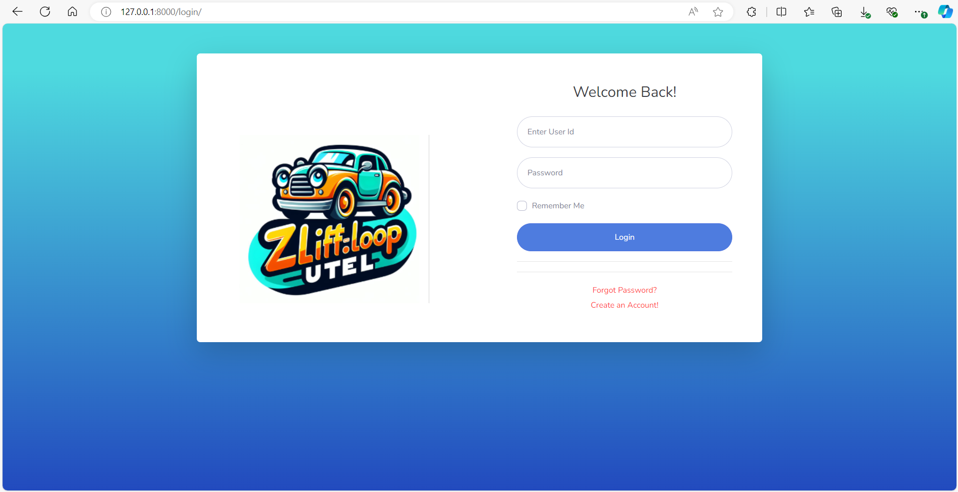
Login Page
The user needs to sign up

Slide 5
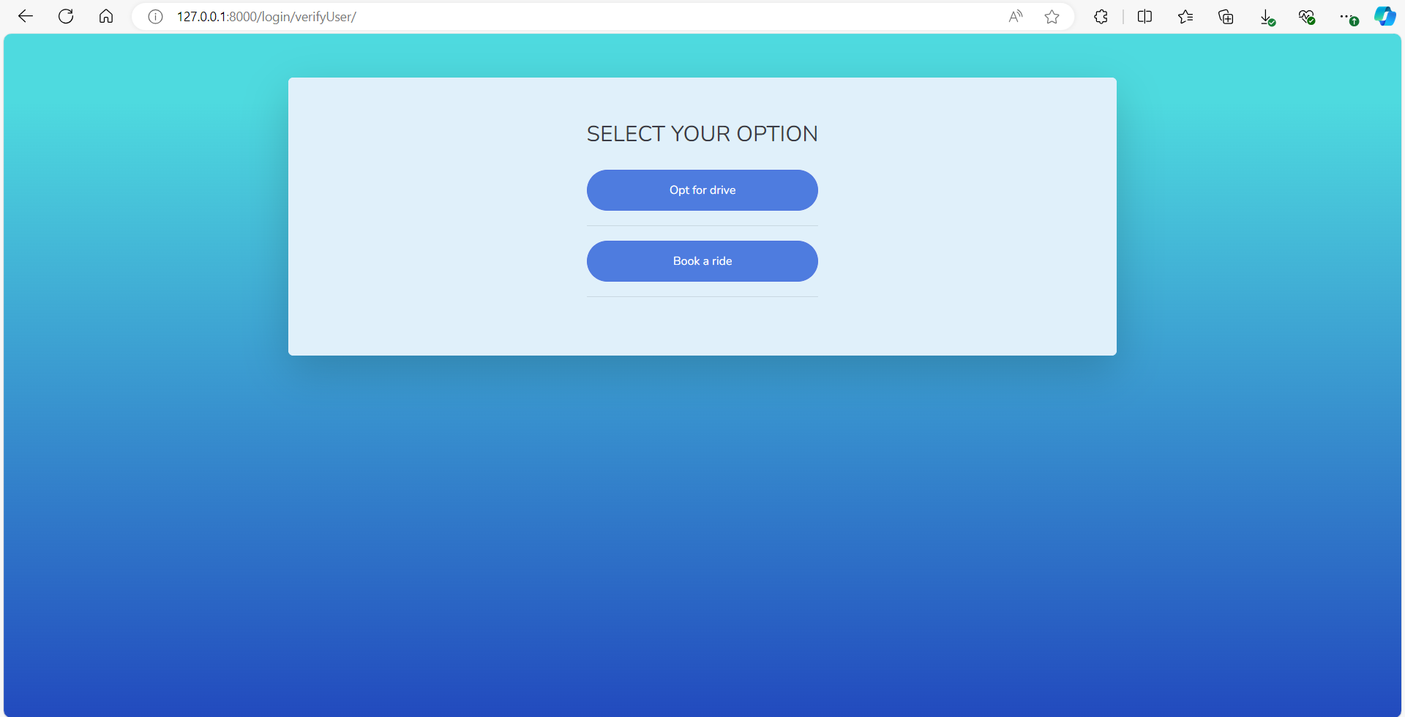
Option Page
After creating an account, the user can choose an option based on their preference.

Slide 6
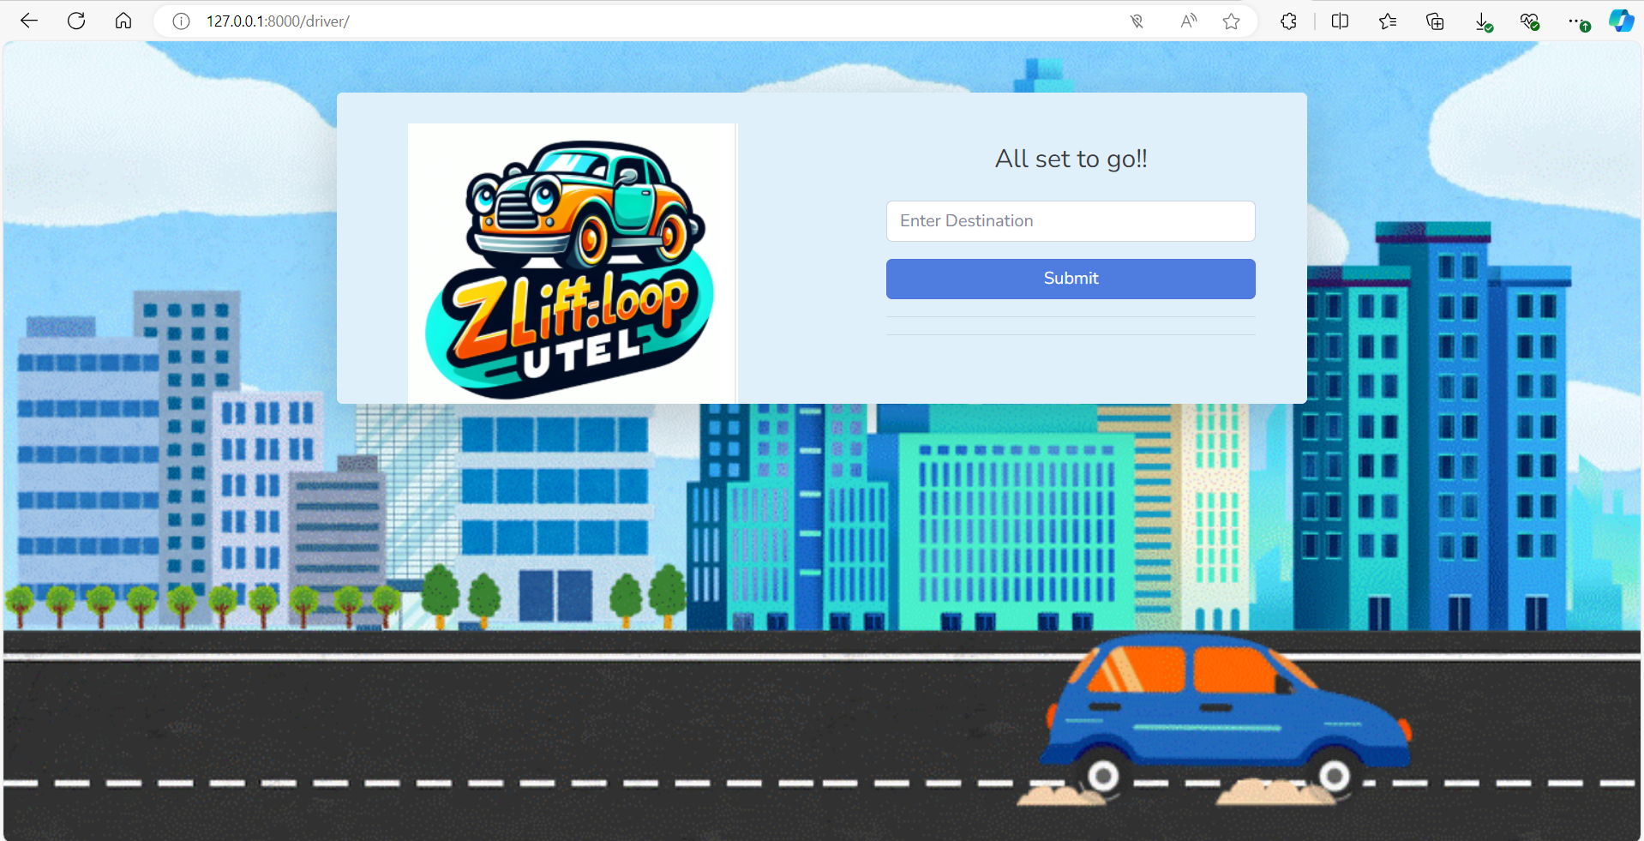
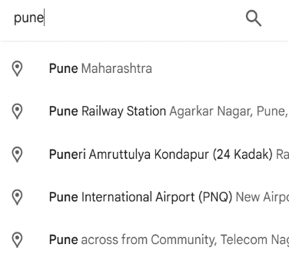
Opt for drive
If the user selects the option “opt for drive”, they will need to specify their destination.

Slide 7
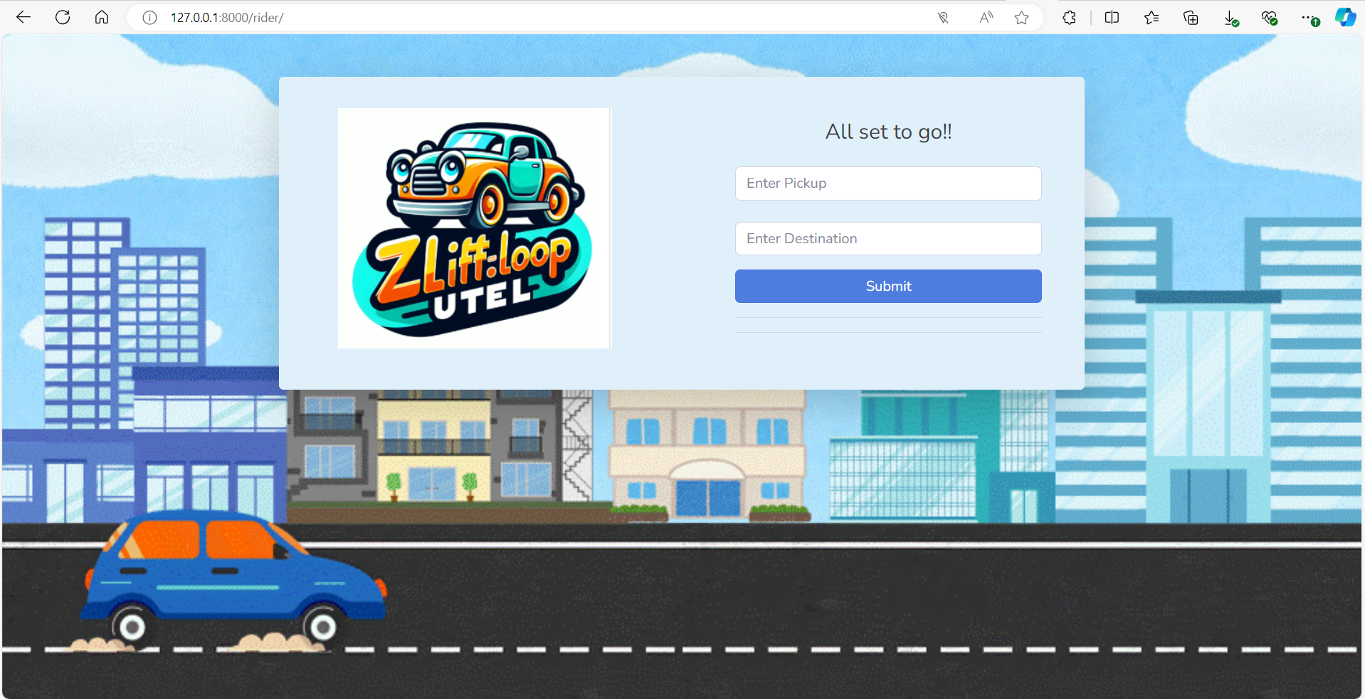
Book a ride
If the user chooses the "Book a Ride" option, they will need to provide the pickup location and destination.

Slide 8
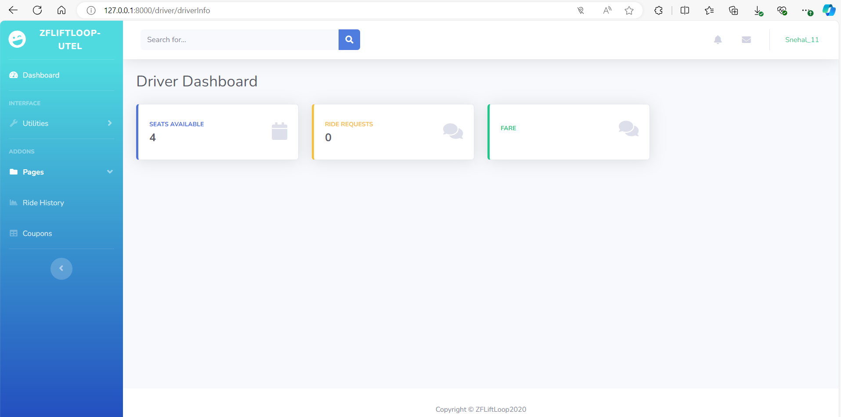
Driver Dashboard
If the user chooses the "Book a Ride" option, they will need to provide the pickup location and destination.

Slide 9
Solution Robustness:
Real-Time Updates: Thanks to the integration of the Google Maps API, the app provides accurate real-time updates about the ride, including estimated time of arrival, route changes, and distance left, ensuring users are always informed.
User Input Flexibility: The application can handle varying user inputs, such as multiple pickup points, different destinations, or last-minute changes in ride details. The system adapts well to these variations.
This level of robustness ensures that UTEL is a reliable solution for daily commuters, even in dynamic and unpredictable environments."

Slide 10
Cost-Benefit Analysis
1. Total Costs for MVP (Minimum Viable Product):
Development Costs:
Frameworks & Tools: The primary technology stack includes the Django framework for backend development, Python for the logic, HTML for frontend development, and the Google Maps API for mapping services. Licensing costs for tools like the Google Maps API.
Google Maps API (for route calculations and real-time traffic updates): Varies based on usage, but initial costs are generally low for small-scale testing.

Slide 11
Employee Experience
UTEL enables employees to share rides with others traveling along the same route, significantly reducing their daily transportation expenses. This financial benefit improves employee satisfaction and reduces the stress of high travel costs.
With UTEL, employees have access to a more predictable and efficient commuting option, including real-time traffic updates and optimized route planning, which reduces overall commute time.
Sharing rides creates opportunities for employees to connect and network with colleagues from different departments or locations. This strengthens workplace relationships, team bonding, and collaboration outside of the office environment.

Slide 12
Creativity & Uniqueness
The blend of technology, sustainability, and community makes UTEL a truly creative and unique solution for modern commuters. Rather than just offering a ride, UTEL reimagines the daily commute as an opportunity for collaboration, well-being, and environmental impact, all while optimizing efficiency and flexibility.
In a world where employees are increasingly looking for solutions that improve not just their work but their overall life experience, UTEL provides a compelling, innovative approach that stands apart from traditional ride-sharing or commuting options.

